Slide 1
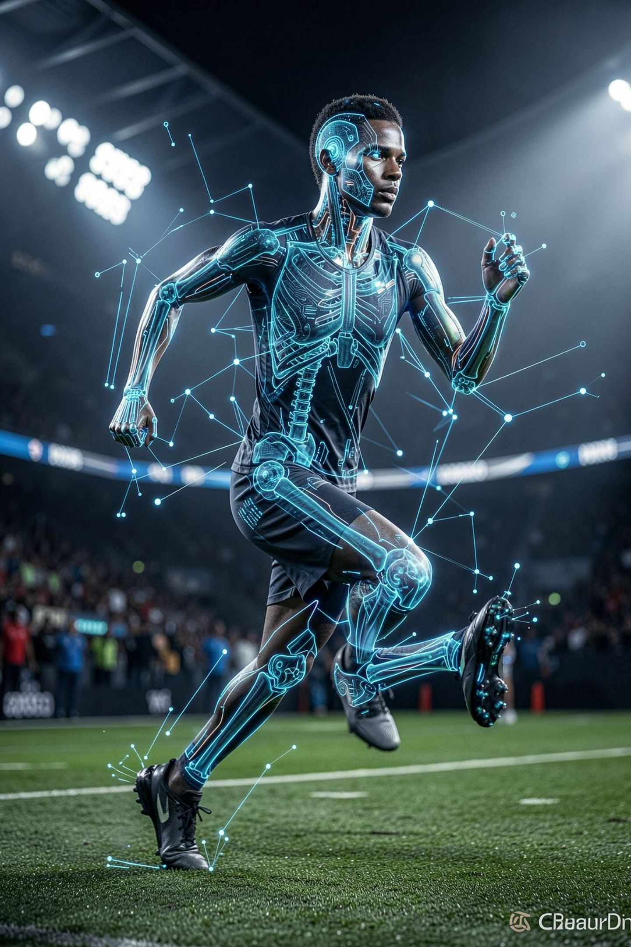
Sports Injury Risk Detection from Video
AI-Powered Athlete Movement & Injury Risk Intelligence
PRESENTED BY :
JYOTHSNA SRI KORADA

Slide 2
Problem Statement : Overcoming Sports Injury Limitations
Despite advancements, athletes continue to face significant injury risks due to gaps in traditional prevention and monitoring methods. Addressing these core problems is crucial for athlete well-being and performance.
High Injury Rates
Delayed Detection
Many athletes experience frequent injuries, leading to downtime, reduced performance, and career impact across various sports.
Subtle biomechanical flaws and nascent movement issues often go unnoticed until they manifest as acute injuries or chronic conditions.
Lack of Real-time Monitoring
Missed Early Interventions
Current assessment methods are often intermittent, failing to provide continuous data and immediate feedback during training or competition.
The delay in identifying problems means that opportunities for timely corrective action and personalized prevention strategies are frequently lost.

Slide 3



Technology Stack & Project Goals
TECHNOLOGY STACK
EVALUATION
EXPECTED IMPACT
Frontend: React.js, JavaScript
Backend: Python, FastAPI
Database: PostgreSQL, MongoDB
AI/ML: OpenCV, MediaPipe, TensorFlow
Pose accuracy
Joint localization accuracy
Biomechanical analysis accuracy
Injury prediction accuracy
Prevent — Identify risks early
Understand — Analyze movement quality
Improve — Optimize athlete performance

Slide 4
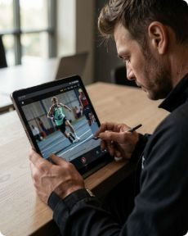
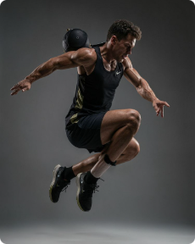
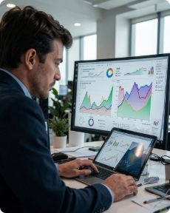

Why Sports Injury Detection?
Movement Analysis
Biomechanical Issues
Risk Prediction
Proactive Prevention
Analyze athlete movement from recorded video and extract motion patterns.
Assess likelihood of injury before it occurs using movement signals.
Provide corrective recommendations and continuous monitoring.
Identify abnormal posture, alignment, and joint behavior.
Flow: Video → AI Analysis → Risk Detection → Prevention

Slide 5
How the System Works
Video Processing
Capture and prepare athlete video for analysis.
Pose Estimation
Detect body keypoints and movement patterns frame by frame.
Risk & Dashboards
Convert motion signals into injury risk insights and monitoring views.

Slide 6
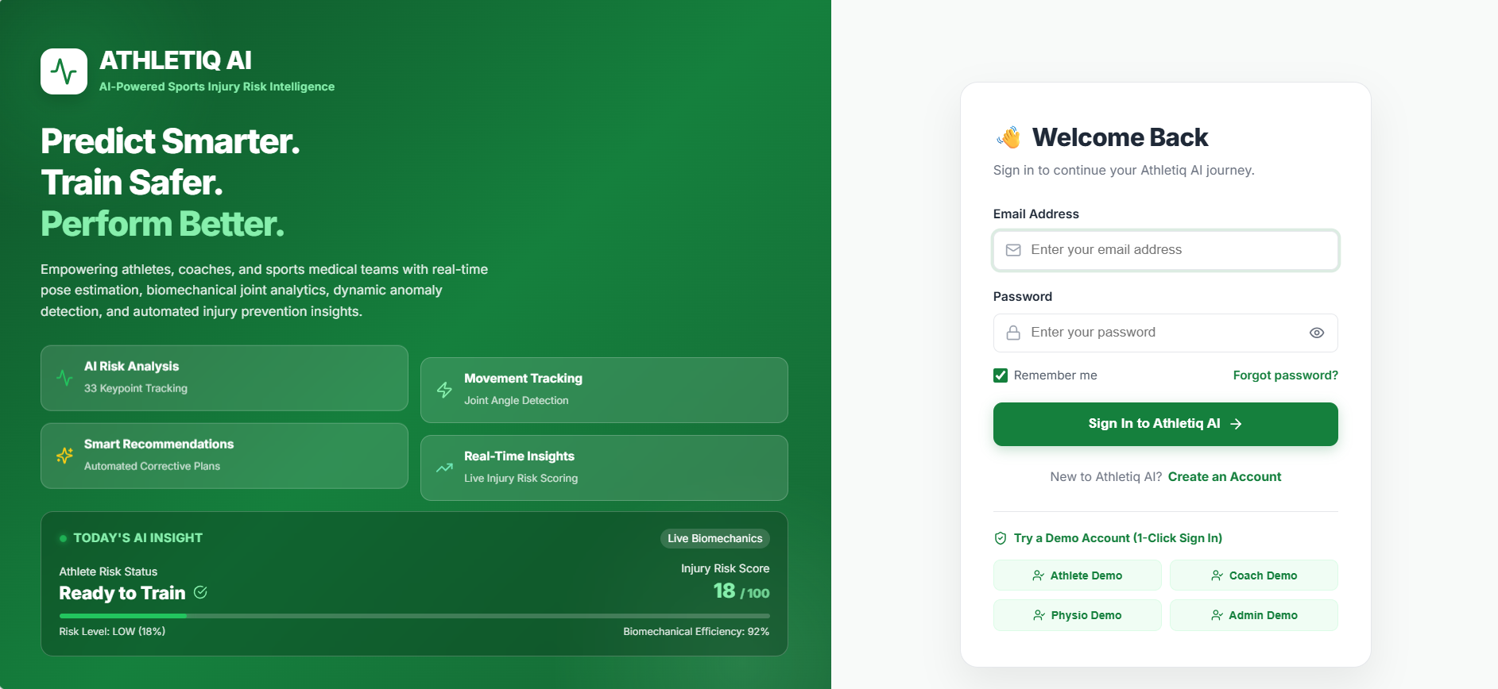
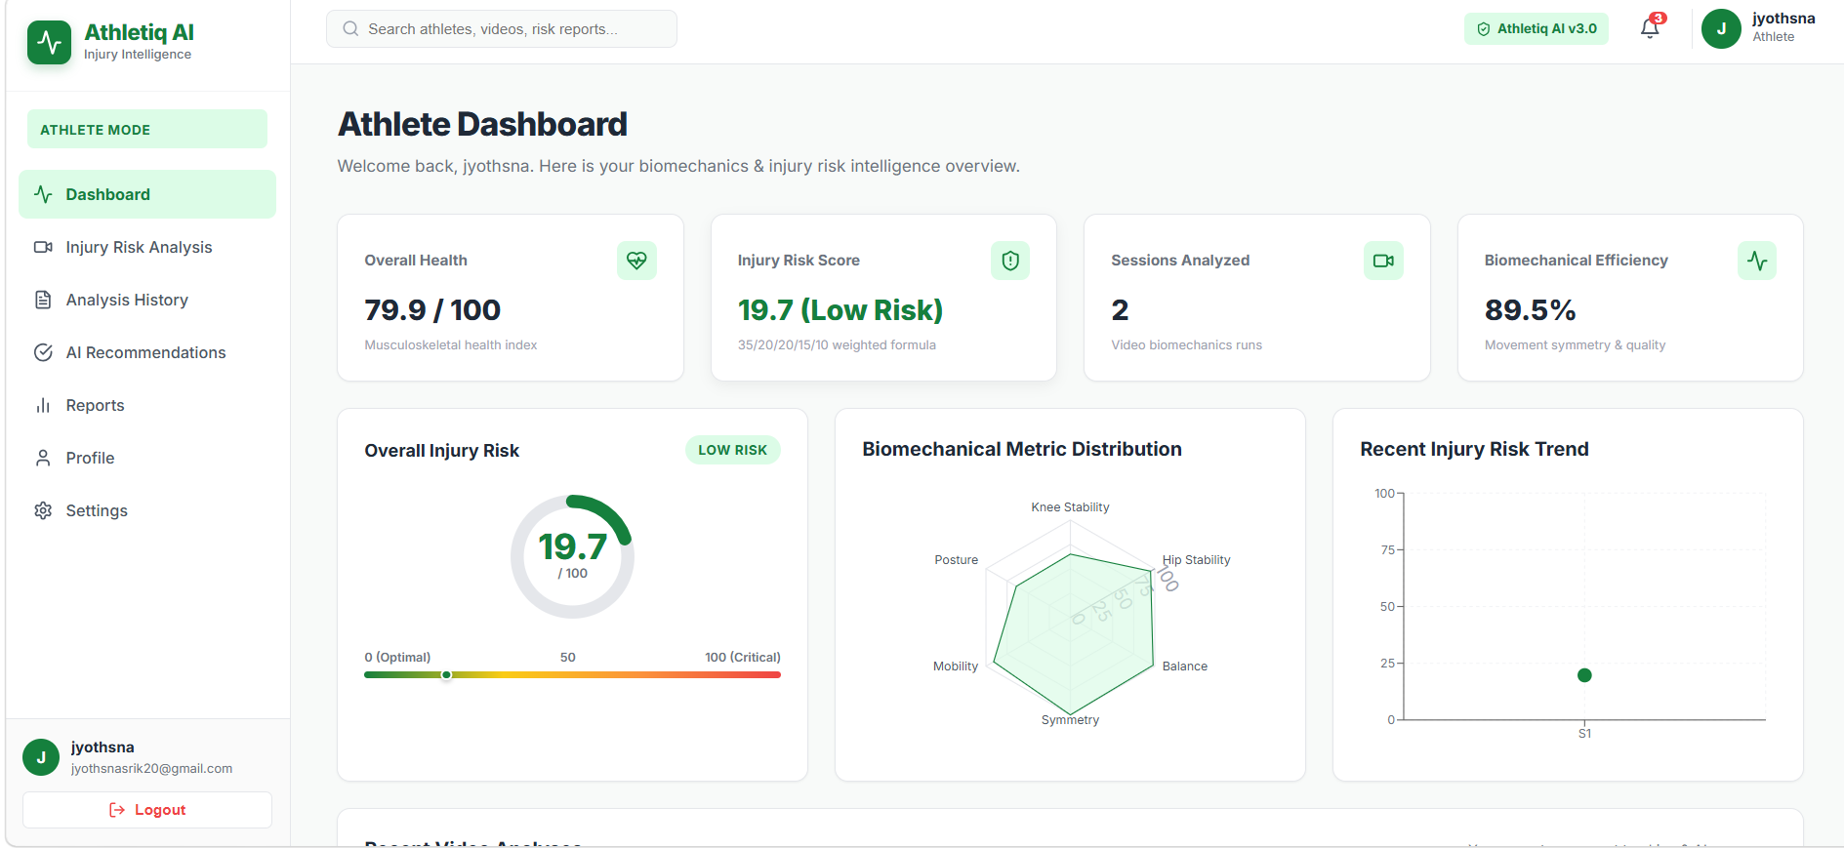
Athletiq Ai -- UI
LOGIN PAGE
ATHLETE DASHBOARD

Slide 7
One Platform, Multiple Users
Athlete
Coach
Physiotherapist
Risk score • Movement reports • Progress • Exercises
Team risk overview • Performance analytics • Training plans
Rehab tracking • Risk monitoring • Recovery reports
Sports Scientist
Administrator
Biomechanical analytics • Injury insights • Research export
User management • Platform monitoring • Reports

Slide 8
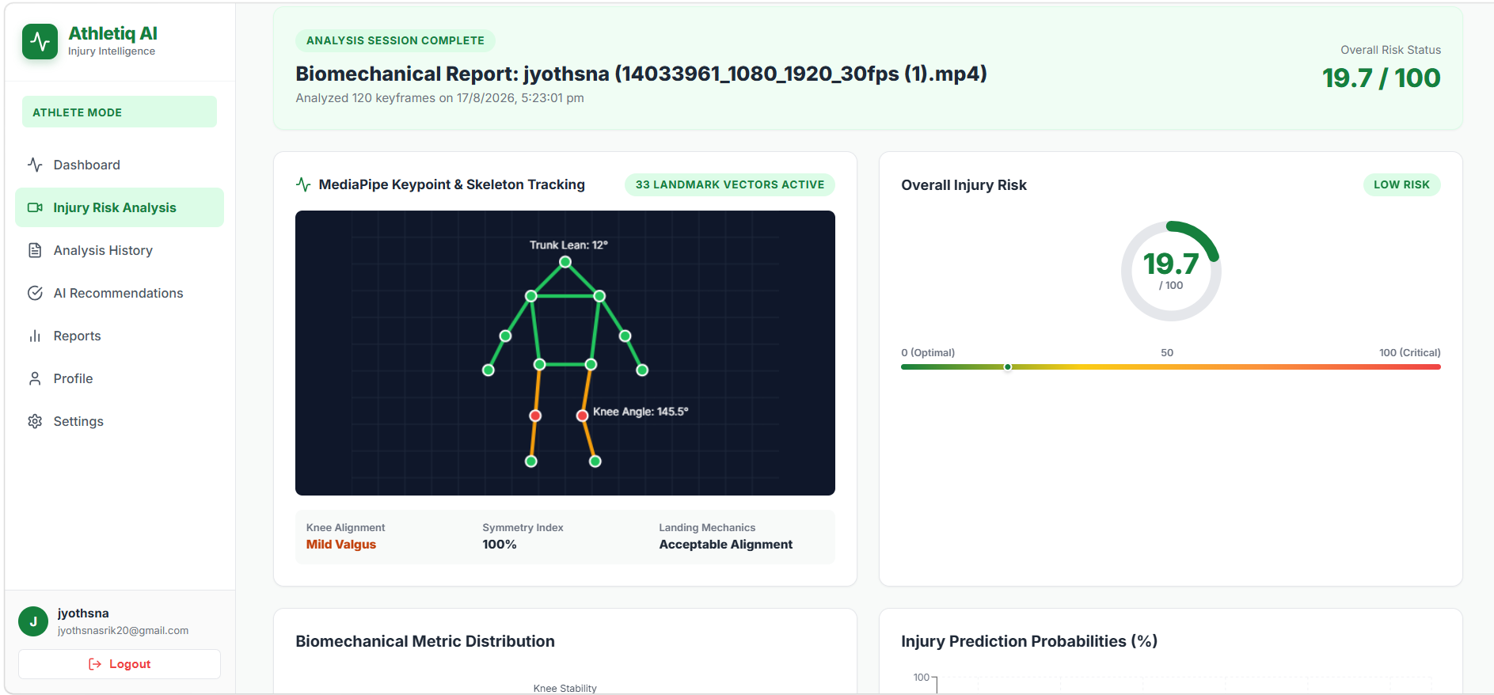
Turning Movement Data into Action
AI Recommendations
Risk Detected → Corrective Action
Exercise & mobility plans
Strengthening & recovery scheduling
Training modification suggestions

Slide 9
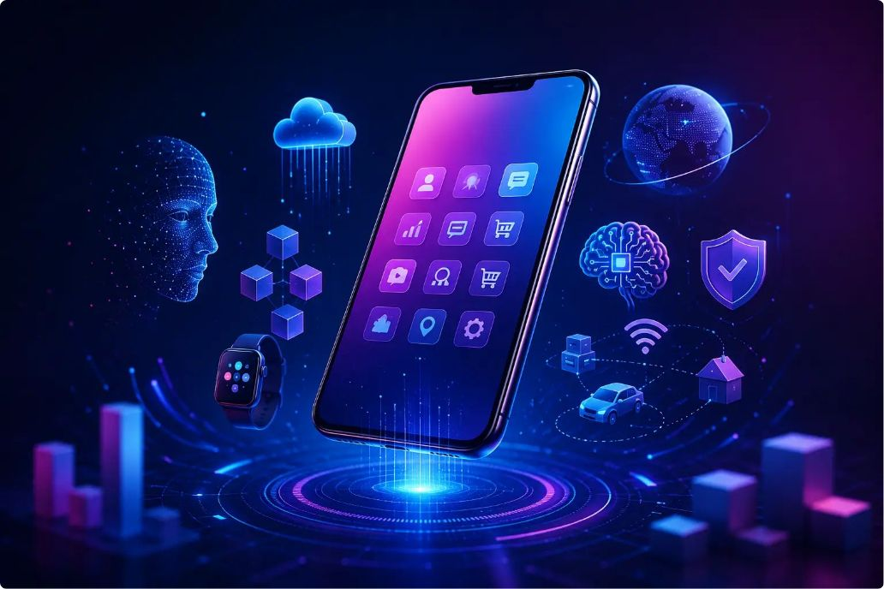
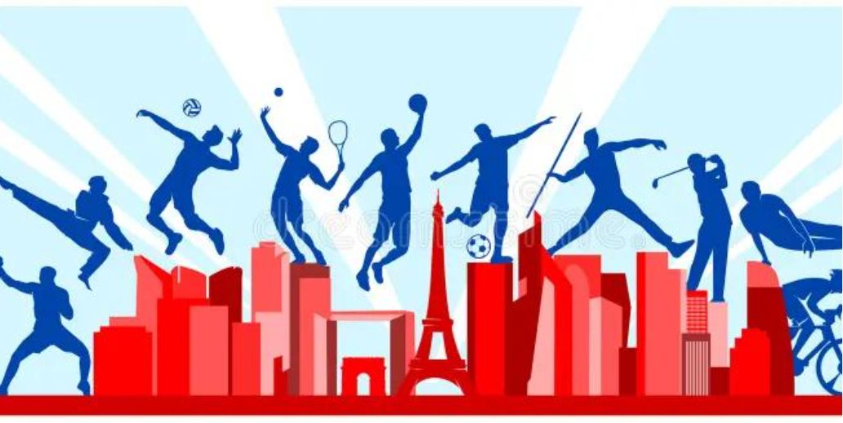
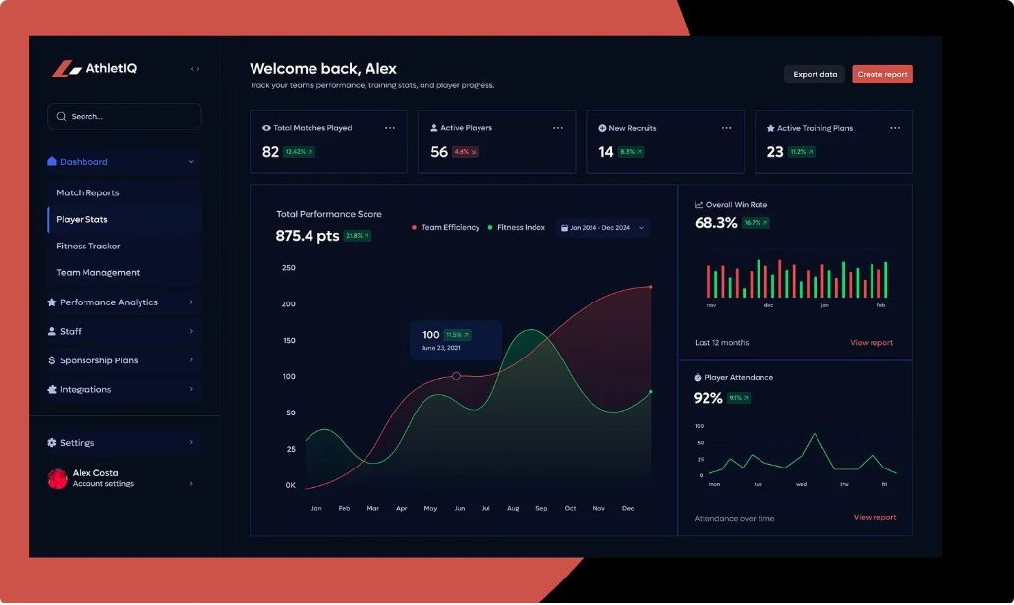
Future Enhancements & Roadmap
Our commitment to athlete safety and performance drives continuous innovation. Here’s what’s next on our roadmap:
Mobile App Expansion Multi-sport Customization Advanced Dashboards

Slide 10
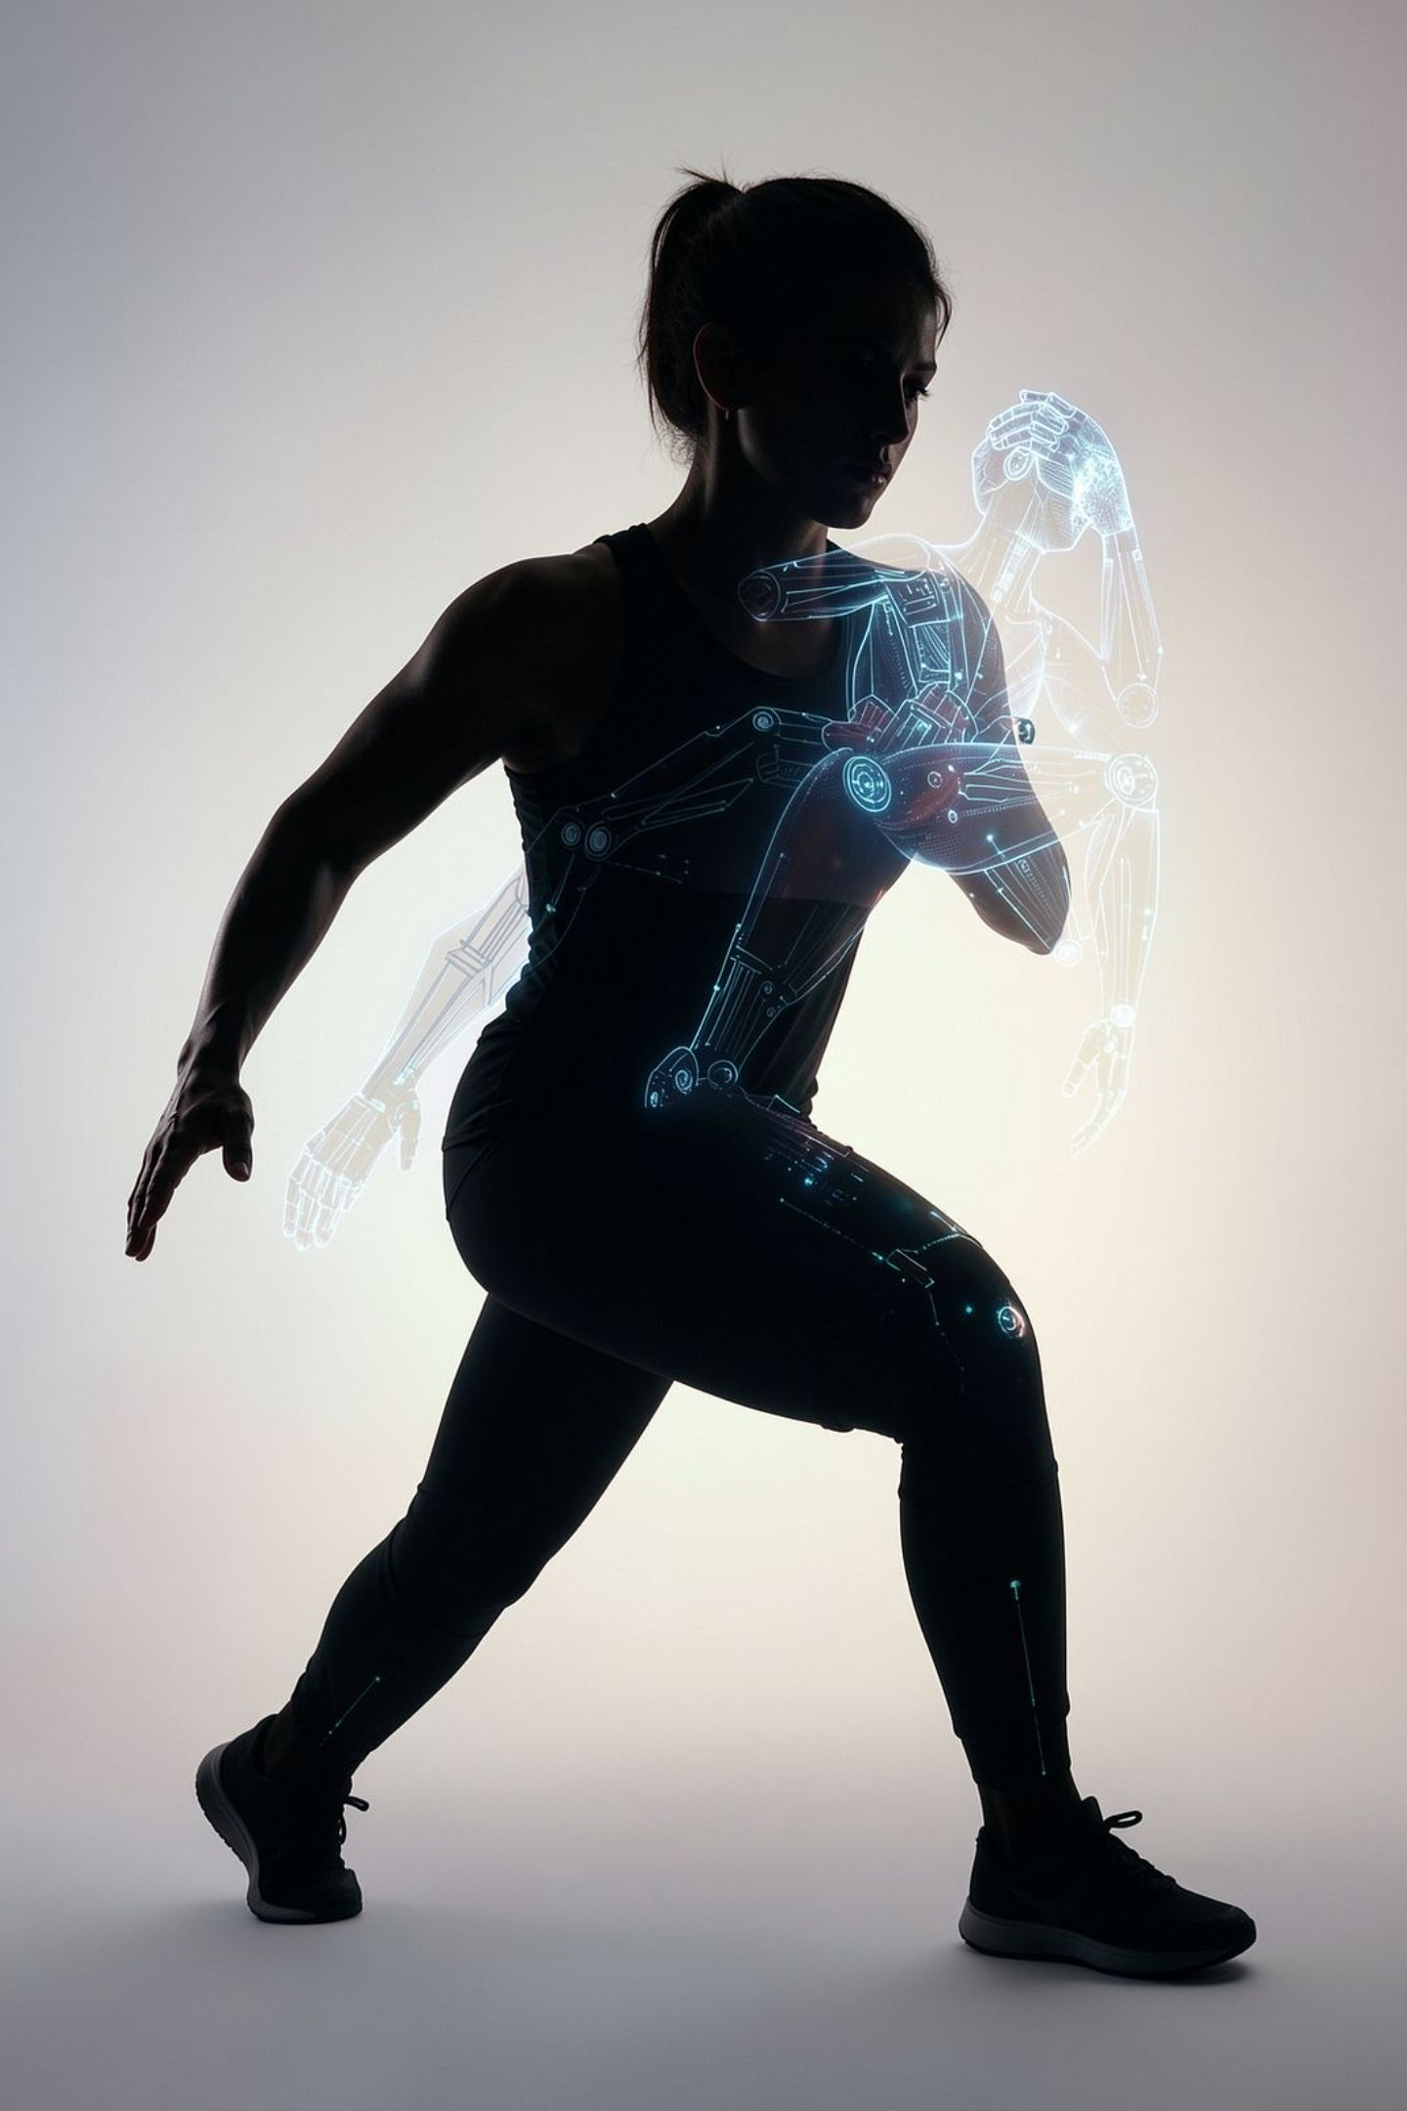
THANK YOU
ANY QUERIES?

